Slide 1
AWS Introduction

Slide 2
Let’s Refresh
Traditional Architecture vs Modern Architecture
AWS Cloud
AWS basic concepts (AZ, Region)
AWS common basic services-
EC2
EBS
Auto Scaling
Load Balancer
VPC
IAM
S3
Route53
CDN
CloudWatch
Sample Architecture

Slide 3
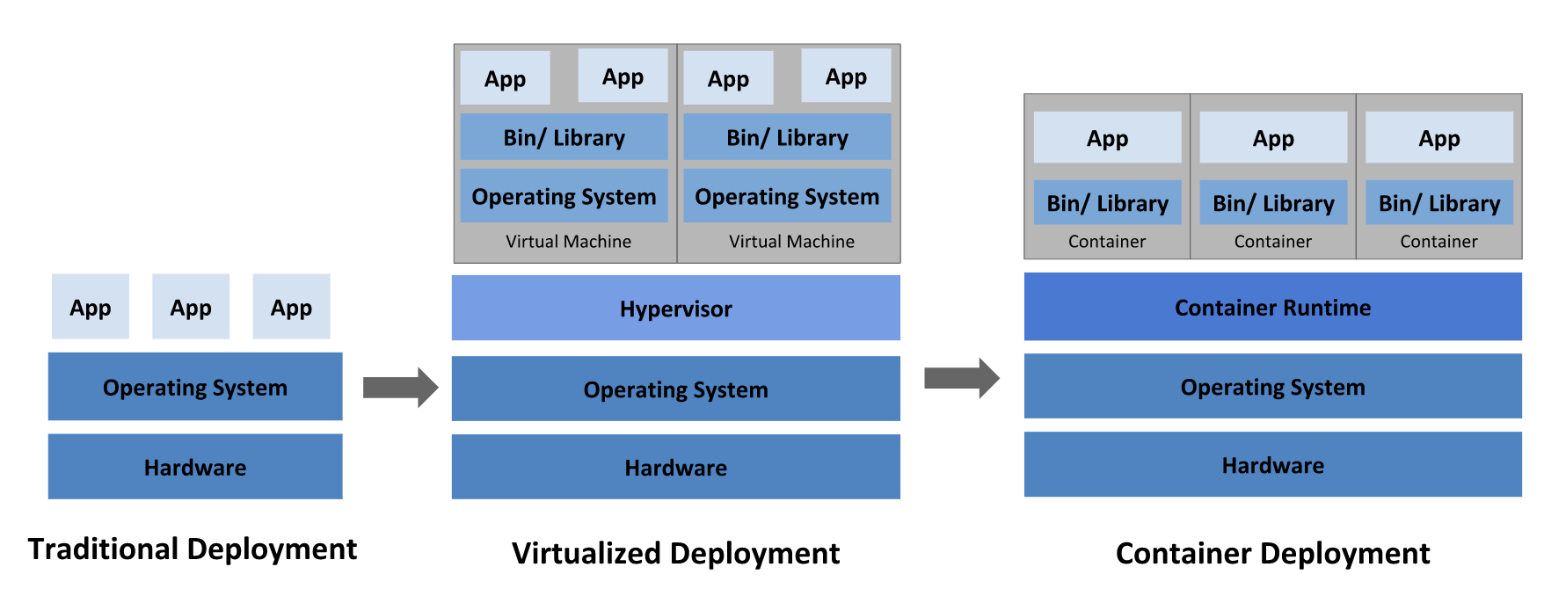
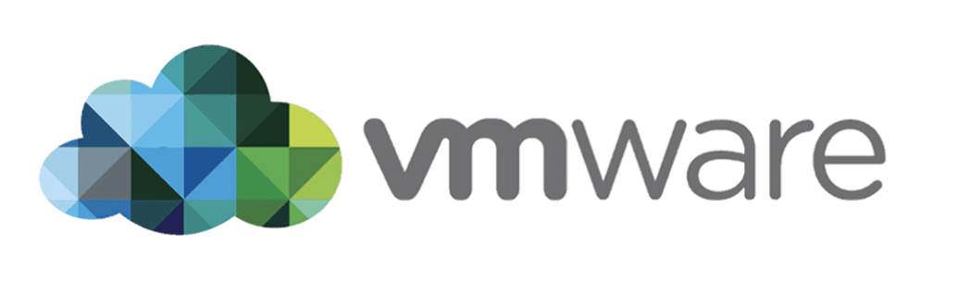
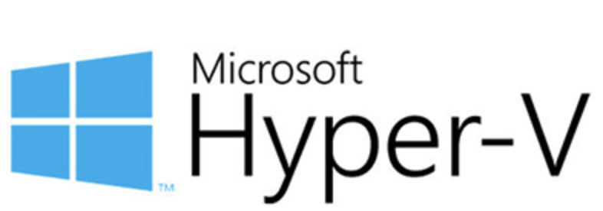
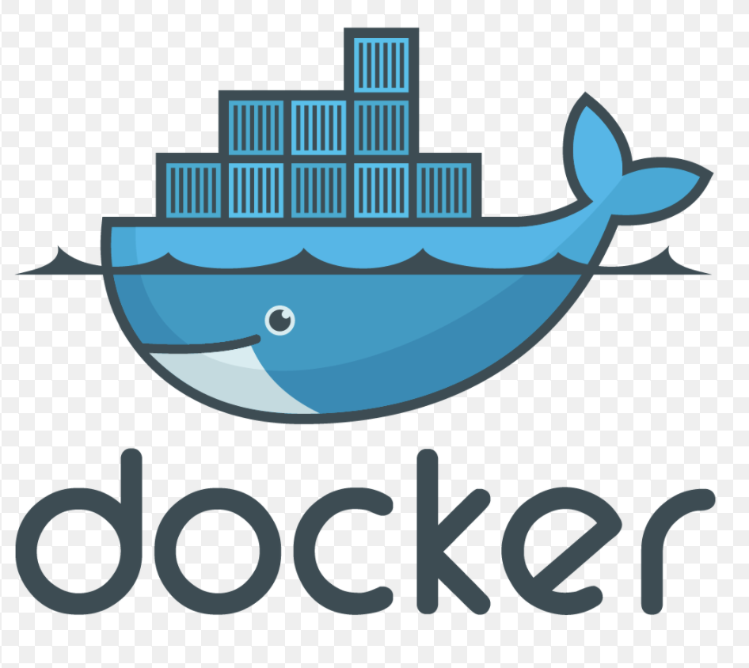

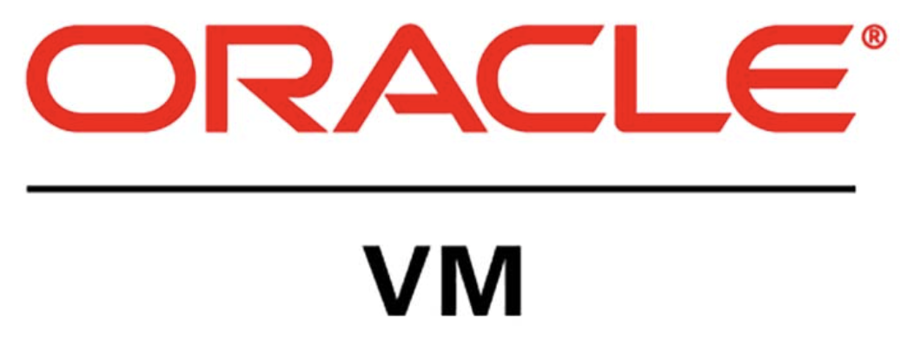
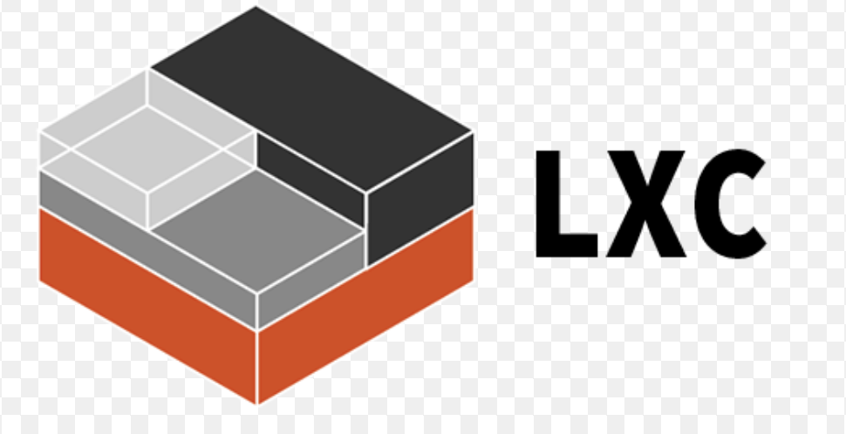
Evolution of deployment methods

Slide 4
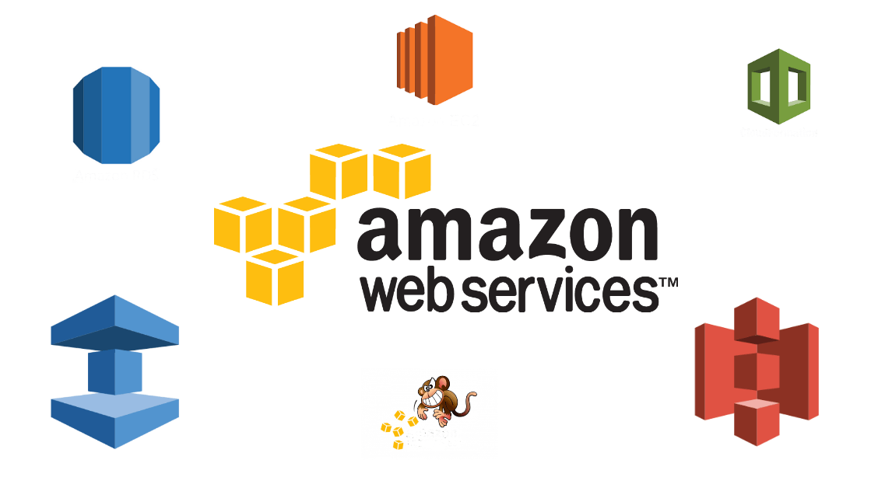
Notes:
Module 1 describes the history and fundamental elements of Amazon Web Services (AWS), as well as how to navigate the AWS Management Console. It discusses the AWS Global Infrastructure, security measures provided by AWS, and basic principles of deploying on AWS.
By the end of this module you will be able to:
Describe the history of AWS
Recognize AWS Global Infrastructure
Navigate the AWS Management Console
Describe the security measures AWS provides

Slide 5
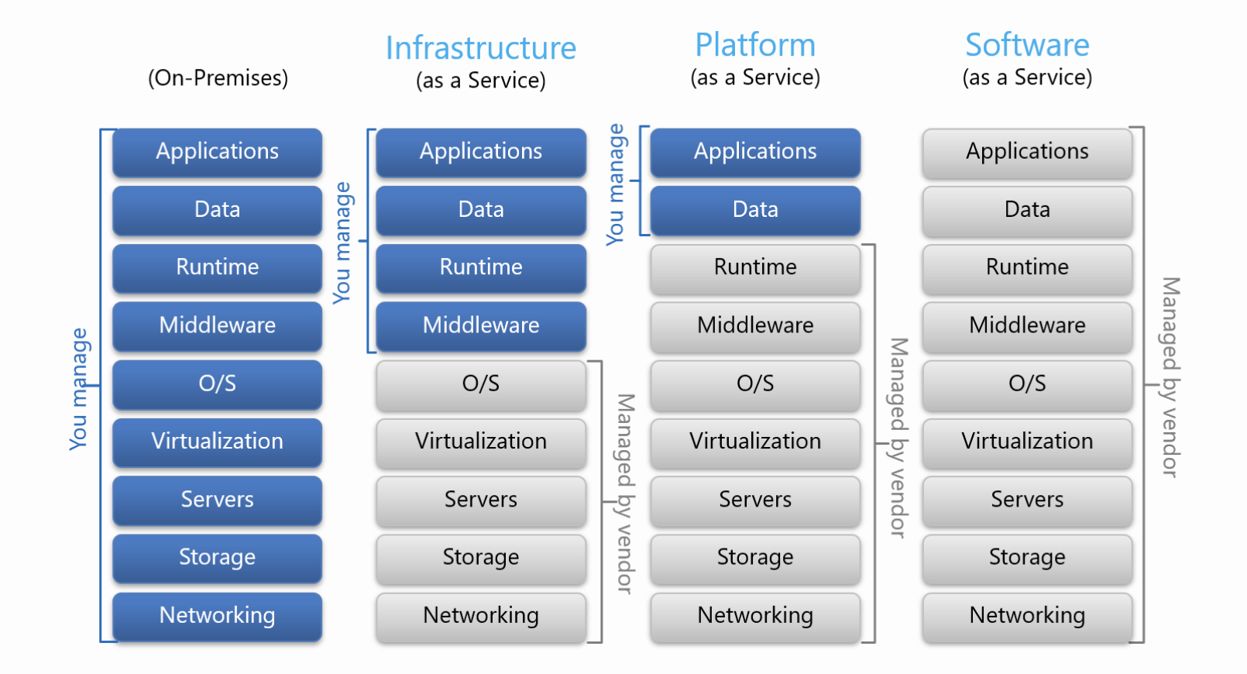
Service Model

Slide 6
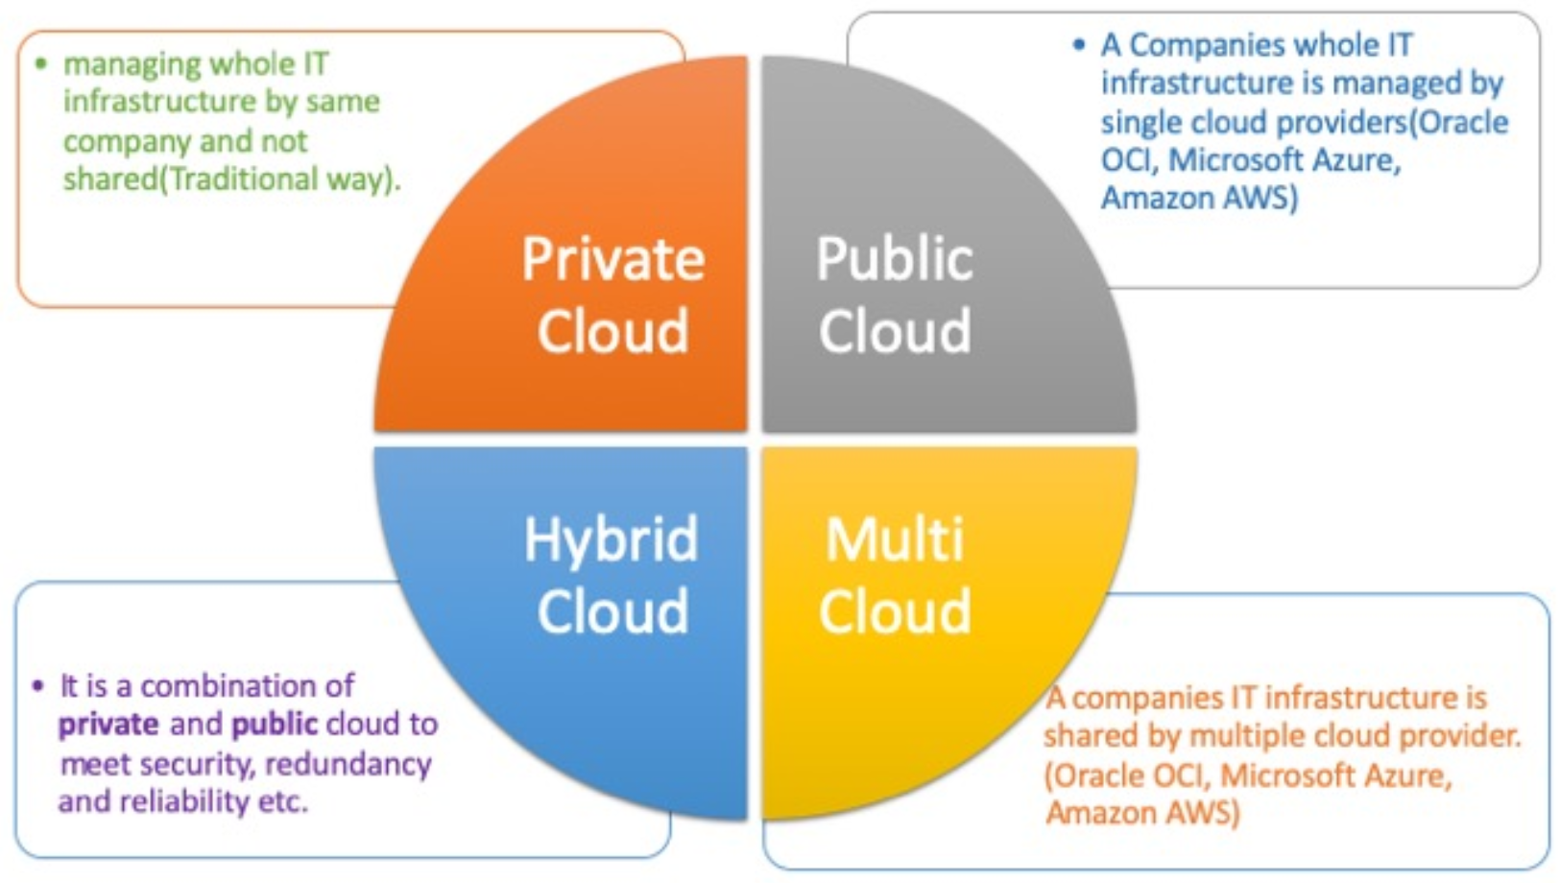
Cloud Deployment Models

Slide 7
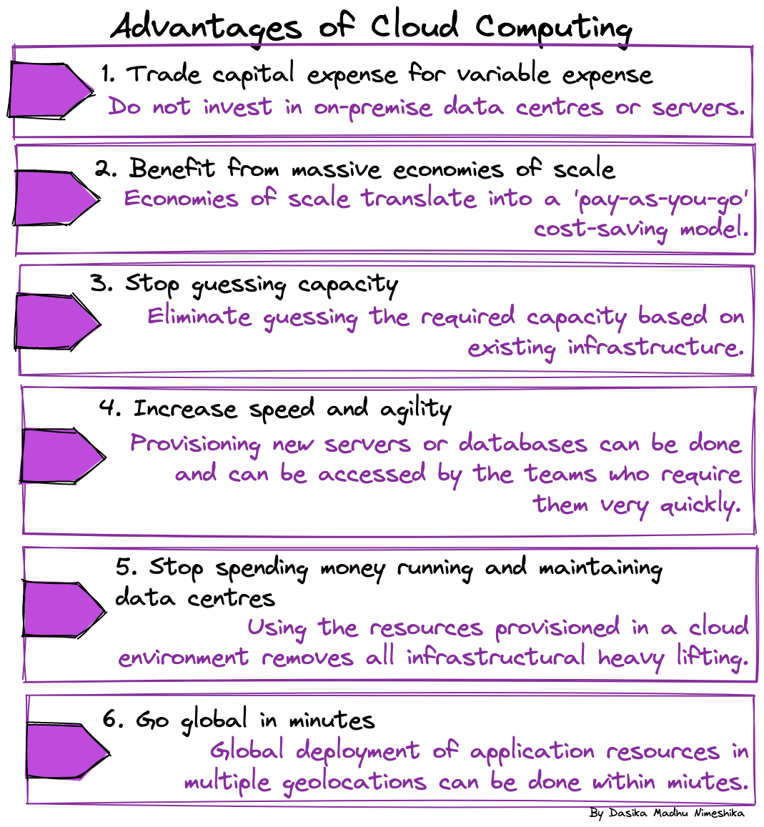
Notes:
AWS provides a massive global cloud infrastructure that allows companies to quickly innovate, experiment, and iterate.
On Demand: AWS gives customers the benefits of utility-based services. Instead of waiting weeks or months for hardware, you can instantly deploy new applications, scale up as the workload grows, and scale down based on demand.
Uniform: Economy of scale and leveraging AWS expertise. AWS customers can leverage the cost effectiveness, scalability, and flexibility of running on AWS infrastructure.
Pay As You Go: With AWS there is zero capital expenditure and no long-term contract.
Available: AWS is accessible via the Web Console, Command Line, API, and SDK.

Slide 8
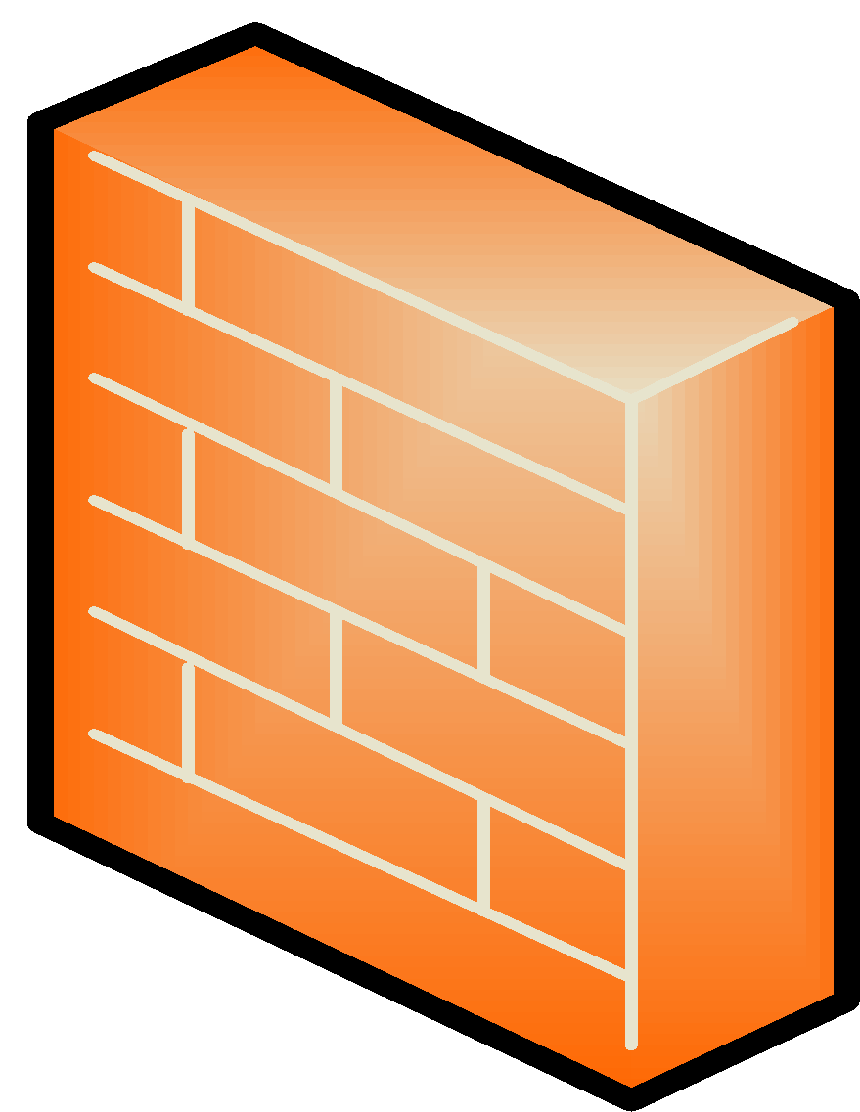





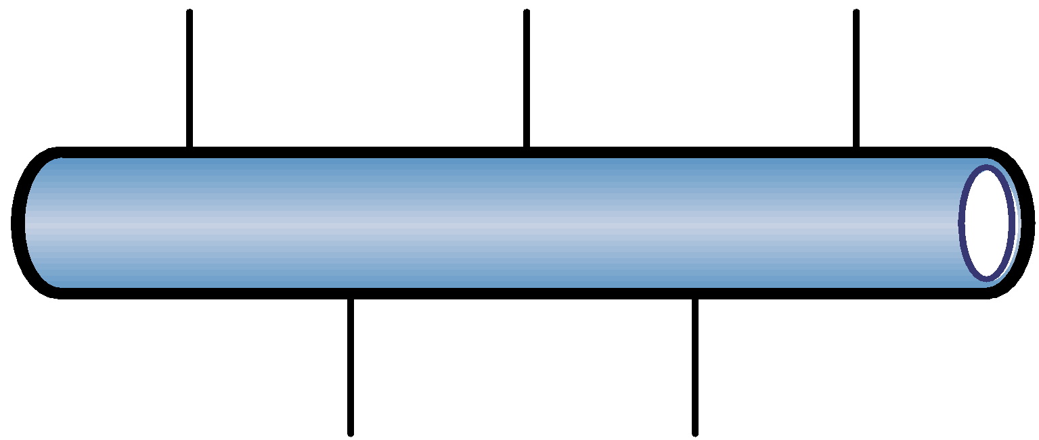




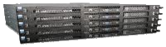


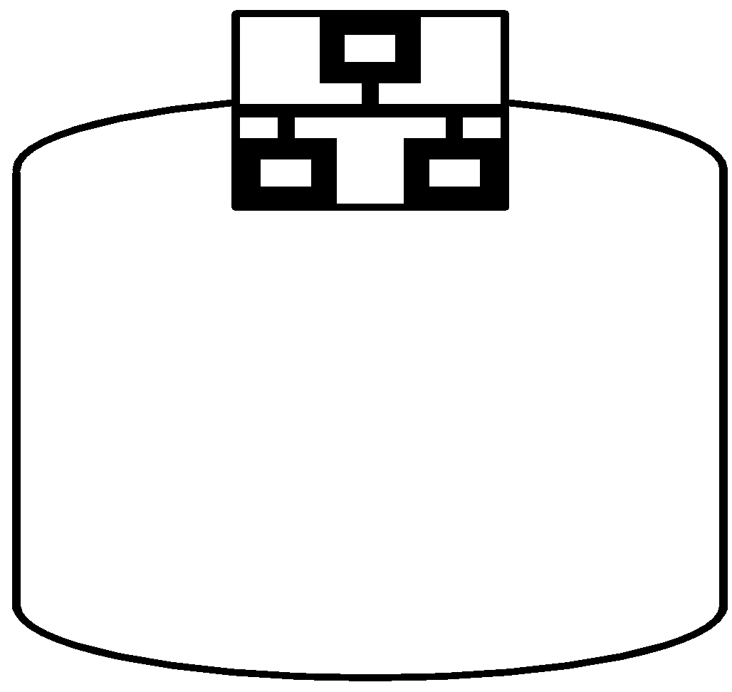




AWS Core Infrastructure & Services
Traditional Infrastructure Amazon Web Services
Security
Security
Security
Physical software - Iptables, Palo Alto
Physical software - Cisco IOS ACLs
Active Directory, LDAP
Security Groups
NACLs
Access Mgmt IAM
Security Groups
NACLs
Access Mgmt
Network
Networking
“Public”
Network
“Public”
Switch
Pipes
Routers
Amazon EC2
ELB
VPC
Provision
EC2 “Classic”
VPC
On-Demand
Servers
VPC
ELB
Physical Servers
Servers
Amazon EC2
AMI
Instances
Storage & Database
NAS
RDBMS
DAS
SAN
Glacier
EBS
S3
RDS
Notes:
Many of our services have analogs in the Traditional IT space and terminology. This side-by-side comparison shows how AWS mirrors a traditional infrastructure with AWS product and services.

Slide 9
AWS Regions and Availability Zones (AZ)
US Regions
Global Regions
US East (VA)
US West (CA)
Asia Pacific (Tokyo)
Asia Pacific (Singapore)
South America (Sao Paulo)
China (Beijing)
AZ - A
AZ - B
AZ - A
AZ - B
AZ - A
AZ - B
AZ - E
AZ - A
AZ - B
AZ - A
AZ - B
AZ - A
AZ - B
AZ - C
AZ - D
AZ - C
AZ - C
Coming Soon
US West (OR)
GovCloud (US)
Asia Pacific (Sydney)
EU (Ireland)
EU (Frankfurt)
AZ - A
AZ - B
AZ - A
AZ - B
AZ - A
AZ - B
AZ - A
AZ - B
AZ - A
AZ - B
AZ - C
AZ - C
Note: Conceptual drawing only. The number of Availability Zones (AZ) may vary.
Notes:
AWS products and services like Amazon Elastic Compute Cloud (Amazon EC2) are offered by region. All regions have at least two Availability Zones (AZ) for redundancy.
Availability Zones are analogous to clusters of datacenters. Where natural disasters or fault lines are a consideration, we isolate them so that they are not easily affected at the same time. There is a latency of less tan 10 milliseconds between Availability Zones. Availability Zones are physically distinct groups of data centers. A region is made of multiple availability zones so as to allow our customers the ability to spread their computing resource across multiple power providers. Where natural disasters are a serious consideration we do our best to isolate AZs from each other. For example, where earthquakes are a problem we would not build two AZs on the same fault line.
More information about AWS global infrastructure can be found online: http://aws.amazon.com/about-aws/global-infrastructure/regional-product-services/
More information about the China Region: https://www.amazonaws.cn/en/

Slide 10

Achieving High Availability Using Multi-AZ
Region
Availability Zone - A
Availability Zone - B
Availability Zone - C
Notes:
AWS highly recommends provisioning your resources across multiple Availability Zones. If you multiple server, you can run them across more than one AZ and get added redundancy. If a single AZ has a problem, all assets in your second AZ will be unaffected.

Slide 11
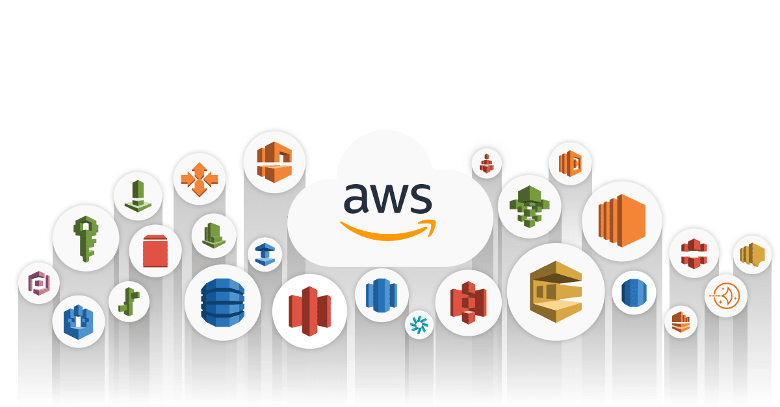
AWS Common Services
Notes:
This module describes the fundamental elements of AWS Compute and Networking, with a focus on Amazon Elastic Compute Cloud. This module will build on what you learned in Module 2 by verifying how to use Amazon Elastic Block Storage.
By the end of this module you will be able to:
Identify the different AWS compute and networking options
Describe what Amazon Virtual Private Cloud is
Create an Amazon Elastic Compute Cloud instance
Verify how to use Amazon Elastic Block Storage

Slide 12
AWS EC2
Notes:
This module describes the fundamental elements of AWS Compute and Networking, with a focus on Amazon Elastic Compute Cloud. This module will build on what you learned in Module 2 by verifying how to use Amazon Elastic Block Storage.
By the end of this module you will be able to:
Identify the different AWS compute and networking options
Describe what Amazon Virtual Private Cloud is
Create an Amazon Elastic Compute Cloud instance
Verify how to use Amazon Elastic Block Storage

Slide 13
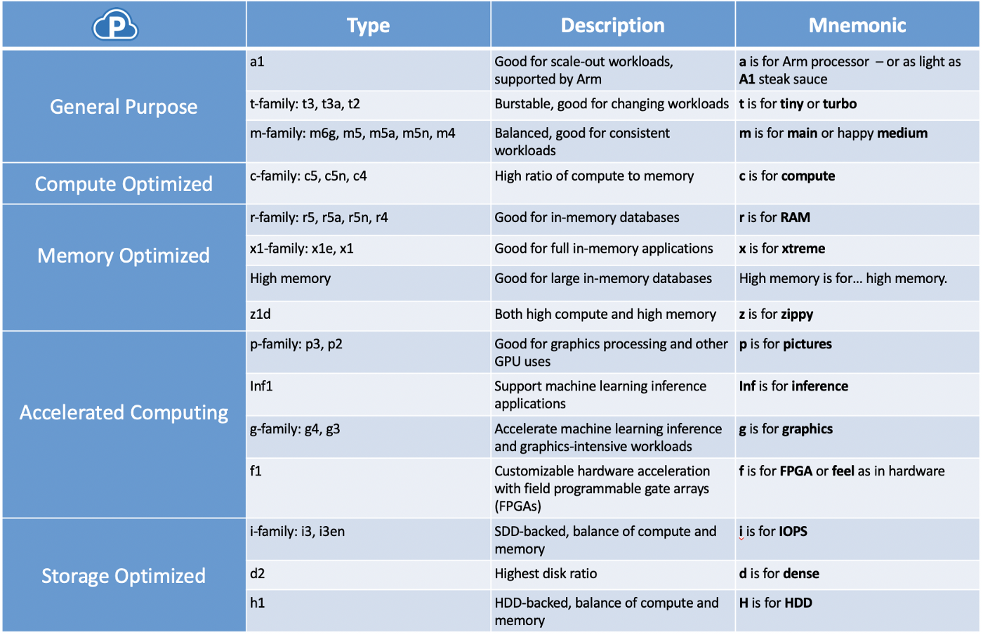
Type of Instance
Notes:
Amazon EC2 is designed to make web-scale computing easier for developers. Amazon EC2’s simple web service interface allows you to obtain and configure capacity with minimal friction. It provides you with complete control of your computing resources and allows you to run on Amazon’s proven computing environment.
Amazon EC2 reduces the time required to obtain and boot new server instances, allowing you to quickly scale capacity, both up and down, as your computing requirements change. Amazon EC2 changes the economics of computing by allowing you to pay only for capacity that you actually use. Amazon EC2 provides the tools for you to build failure-resilient applications and isolate themselves from common failure scenarios.

Slide 14
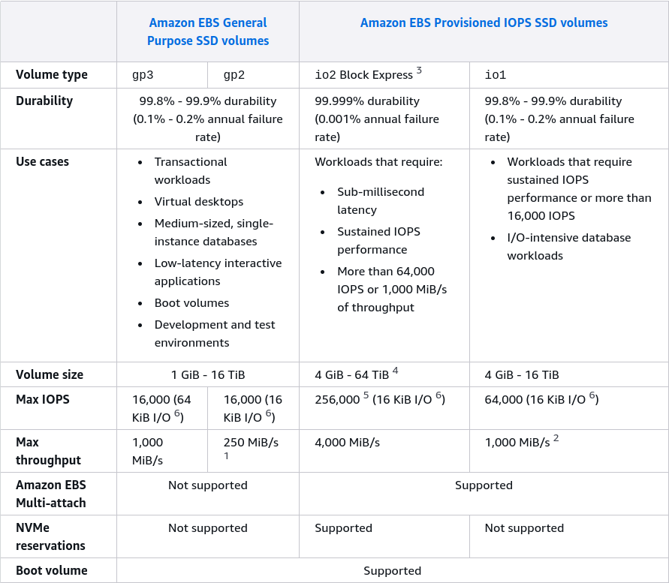
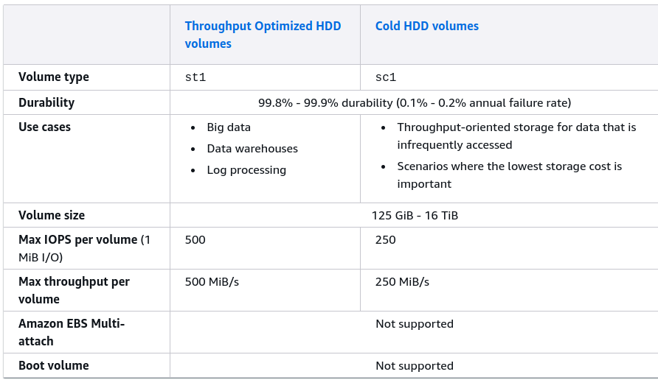
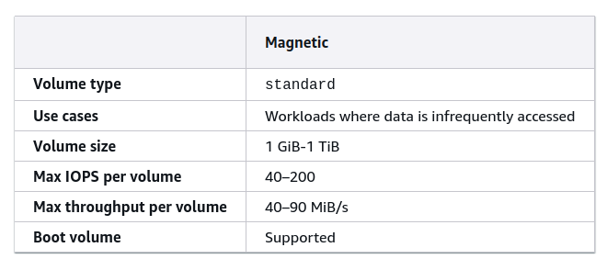
Amazon EBS
Notes:
Amazon EC2 presents a true virtual computing environment, allowing you to use web service interfaces to launch instances with a variety of operating systems, load them with your custom application environment, manage your network’s access permissions, and run your image using as many or few systems as you need.
You have the ability to programmatically scale your computing capacity as your requirements change. You pay only for capacity that you actually use and can choose Linux or Windows. You can leverage the AWS’ global infrastructure to deploy across regions and Availability Zones (AZs) for reliability.

Slide 15

Auto Scaling
Scale your Amazon EC2 capacity automatically
Well-suited for applications that experience variability in usage
Available at no additional charge
Auto Scaling
Notes:
Auto Scaling is particularly well suited for applications that experience hourly, daily, or weekly variability in usage. Auto Scaling is enabled by Amazon CloudWatch and available at no additional charge beyond the Amazon CloudWatch fees.

Slide 16
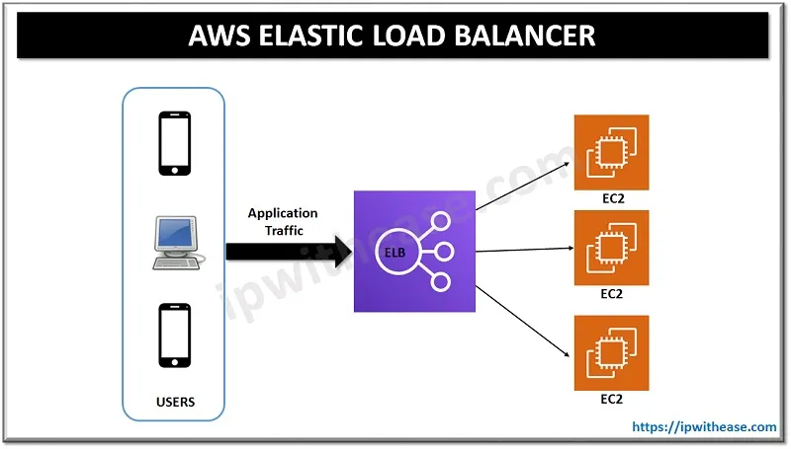

Slide 17
AWS Networking Services & Security
Notes:
This module describes the fundamental elements of AWS Compute and Networking, with a focus on Amazon Elastic Compute Cloud. This module will build on what you learned in Module 2 by verifying how to use Amazon Elastic Block Storage.
By the end of this module you will be able to:
Identify the different AWS compute and networking options
Describe what Amazon Virtual Private Cloud is
Create an Amazon Elastic Compute Cloud instance
Verify how to use Amazon Elastic Block Storage

Slide 18

Amazon Virtual Private Cloud (VPC)
Provision a private, isolated section of the AWS Cloud where you can launch AWS resources in a virtual network that you define.
Have complete control over your virtual networking environment.
Amazon
VPC
Notes:
With Amazon Virtual Private Cloud (VPC), you can define a virtual network topology that closely resembles a traditional network that you might operate in your own datacenter. You have complete control over your virtual networking environment and you can easily customize the network configuration for your Amazon VPC such as selection of IP address range, creation of subnets, configuration of route tables, and network gateways.

Slide 19
Common terms related to VPC
Subnet
Route tables
Internet Gateway
Nat Gateway
Elastic IP
Peering
Endpoints
Amazon
VPC
Notes:
With Amazon Virtual Private Cloud (VPC), you can define a virtual network topology that closely resembles a traditional network that you might operate in your own datacenter. You have complete control over your virtual networking environment and you can easily customize the network configuration for your Amazon VPC such as selection of IP address range, creation of subnets, configuration of route tables, and network gateways.

Slide 20
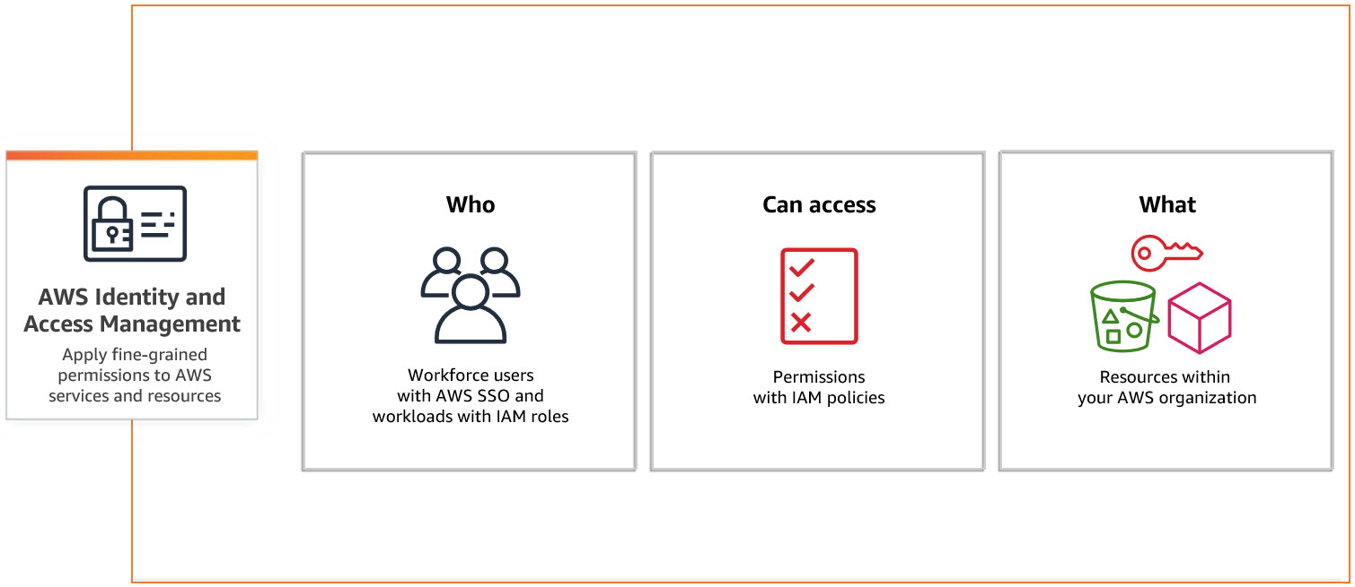
AWS Identity and Access Management (IAM)
Notes:
Using AWS IAM you can create and manage AWS users and groups and use permissions to allow and deny their access to AWS resources. You can use existing corporate identities to grant secure access to AWS resources, such as Amazon S3 buckets, without creating any new AWS identities.
Introduction training video on AWS IAM and a free self-paced lab: http://youtu.be/yv0RByTsYf4

Slide 21

Common terms related to IAM
User
Groups
Role
Policy
Amazon
IAM
Notes:
With Amazon Virtual Private Cloud (VPC), you can define a virtual network topology that closely resembles a traditional network that you might operate in your own datacenter. You have complete control over your virtual networking environment and you can easily customize the network configuration for your Amazon VPC such as selection of IP address range, creation of subnets, configuration of route tables, and network gateways.

Slide 22
AWS Storage & Content Delivery
Notes:
Module 2 describes the key features of AWS storage and content delivery.
By the end of this module you will be able to:
Identify key AWS storage options
Describe Amazon EBS
Create an Amazon S3 bucket and manage associated objects

Slide 23
Amazon Simple Storage Service (S3)
Bucket policy
Bucket Versioning
Transfer acceleration
Static website hosting
Lifecycle rules
Amazon S3
Notes:
Amazon S3 is designed to make web-scale computing easier for developers. Amazon S3 provides a simple web services interface that can be used to store and retrieve any amount of data, at any time, from anywhere on the web. It gives any developer access to the same highly scalable, reliable, secure, fast, inexpensive infrastructure that Amazon uses to run its own global network of web sites.
Learn more about Amazon S3: http://aws.amazon.com/s3/

Slide 24
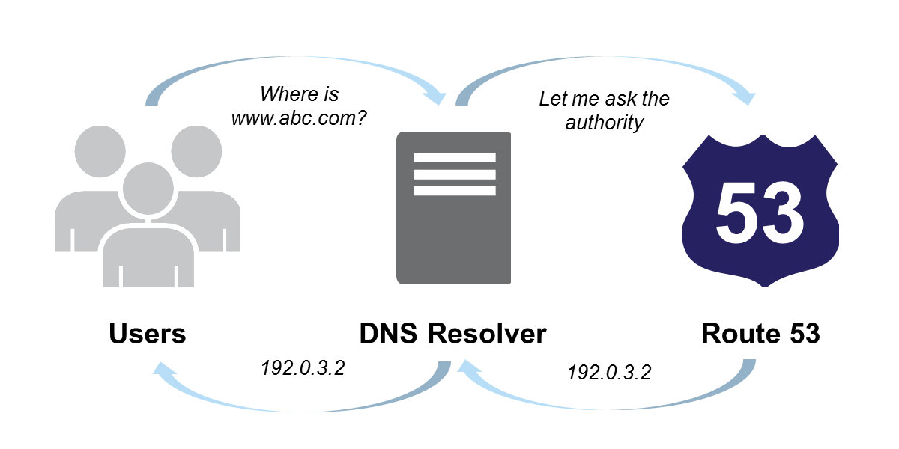
Amazon Route 53
Notes:
Amazon Route 53 provides secure and reliable routing to your application instance. Amazon Route 53 automatically routes queries to the nearest DNS server in a global network of DNS servers, resulting in low latency. You can use Amazon Route 53 to configure DNS health-checks to route traffic to healthy endpoints or to independently monitor the health of your application and its endpoints. Amazon Route 53 offers Domain Name Registration so you can purchase and manage domain names such as example.com and Route 53 will automatically configure DNS settings for your domains.
More information about Amazon Route 53: http://aws.amazon.com/route53/

Slide 25

How to Use Amazon Route 53
If you don’t already have a domain name:
Register domain name
Automatically creates hosted zones
If you already have a domain name:
Create a hosted zone
Transfer your domain name or update DNS servers
Notes:
Amazon Route 53 has a simple web service interface that lets you get started in minutes. If you don’t already have a domain name, then you would register your new domain name. Amazon Route 53 will automatically create a hosted zone that stores DNS records for your domain. Much like a phone book, the Internet’s DNS system manages mapping between names and numbers. With DNS, the names are domain names (www.example.com) that are easy for your users to remember. Instead of phone numbers, in DNS, these names are mapped to IP addresses (192.0.2.1) that specify the location of computers on the Internet. Route 53 performs two DNS functions; first, it allows you to manage the IP addresses listed for your domain names in the Internet’s DNS phone book. These listings are called DNS “records.” Second, like a directory assistance service, Amazon Route 53 answers requests to translate specific domain names into their corresponding IP addresses. These requests are called “queries.” You pay only for managing domains through the service and for the number of queries that the service answers.
If you already have a domain name, then you would create a hosted zone that can store DNS records for your domain. You can also transfer your domain name to Amazon Route 53 and inform the registrar to update the name servers for your domain to the ones associated with your hosted zone.

Slide 26

Amazon CloudFront
Easy and cost effective way to distribute content to end users
Low latency, high data transfer speeds
Deliver your entire website, including dynamic, static, streaming, and interactive content using a global network of edge locations
Amazon CloudFront
Notes:
Amazon CloudFront integrates with other Amazon Web Services to give developers and businesses an easy way to distribute content to end users with low latency, high data transfer speeds, and no minimum commitments. You can use Amazon CloudFront to deliver your entire website.

Slide 27
AWS CloudWatch
Notes:
Module 2 describes the key features of AWS storage and content delivery.
By the end of this module you will be able to:
Identify key AWS storage options
Describe Amazon EBS
Create an Amazon S3 bucket and manage associated objects

Slide 28
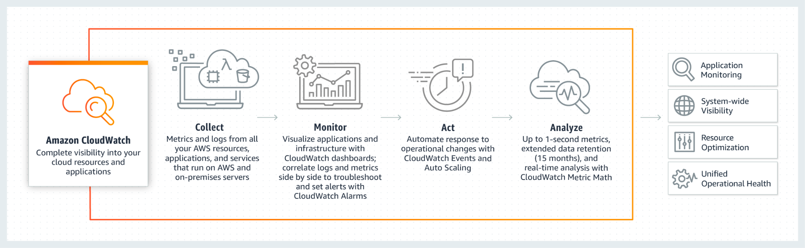
Amazon CloudWatch
Notes:
CloudWatch lets you view graphs, set alarms to troubleshoot, spot trends, and take automated action based on the state. It is accessible via the AWS Management Console, APIs, SDK or CLI. You can customize with your own metrics or use a sample template found online.

Slide 29
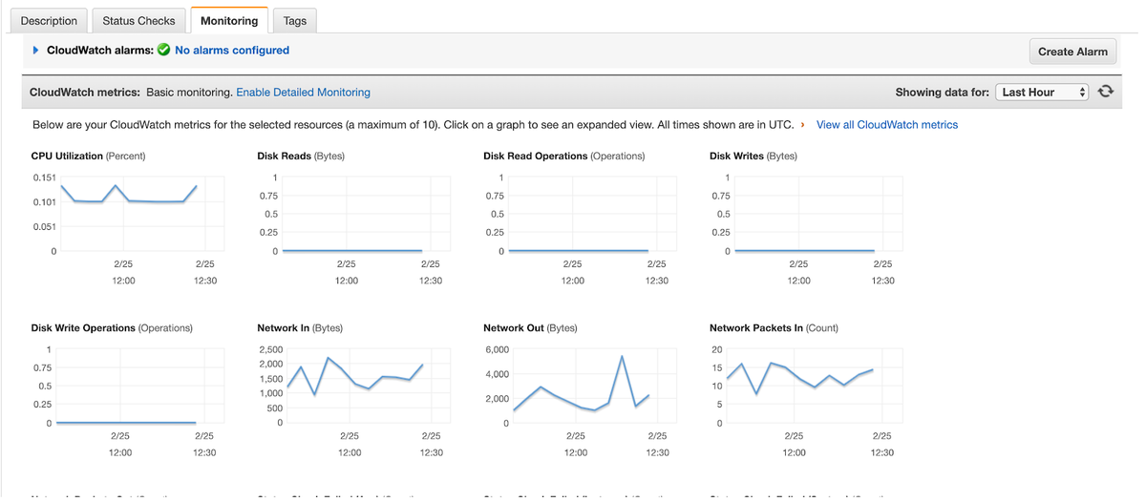
Amazon CloudWatch
Notes:
For Amazon EC2 instances, Amazon CloudWatch basic monitoring collects and reports metrics for CPU utilization, data transfer, and disk usage activity from each Amazon EC2 instance at a five-minute frequency. Amazon CloudWatch detailed monitoring provides these same metrics at one-minute intervals, and also enables data aggregation by Amazon EC2 AMI ID and instance type.
Set alarms on any of your metrics to receive notifications. You can also use Auto Scaling to add or remove Amazon instances.
Here is a step-by-step guide on creating Amazon CloudWatch Alarms: http://docs.aws.amazon.com/AmazonCloudWatch/latest/DeveloperGuide/AlarmThatSendsEmail.html
More information about monitoring other AWS resources: https://aws.amazon.com/cloudwatch/details/#other-aws-resource-monitoring

Slide 30
AWS Sample Architecture
Notes:
Module 2 describes the key features of AWS storage and content delivery.
By the end of this module you will be able to:
Identify key AWS storage options
Describe Amazon EBS
Create an Amazon S3 bucket and manage associated objects

Slide 31
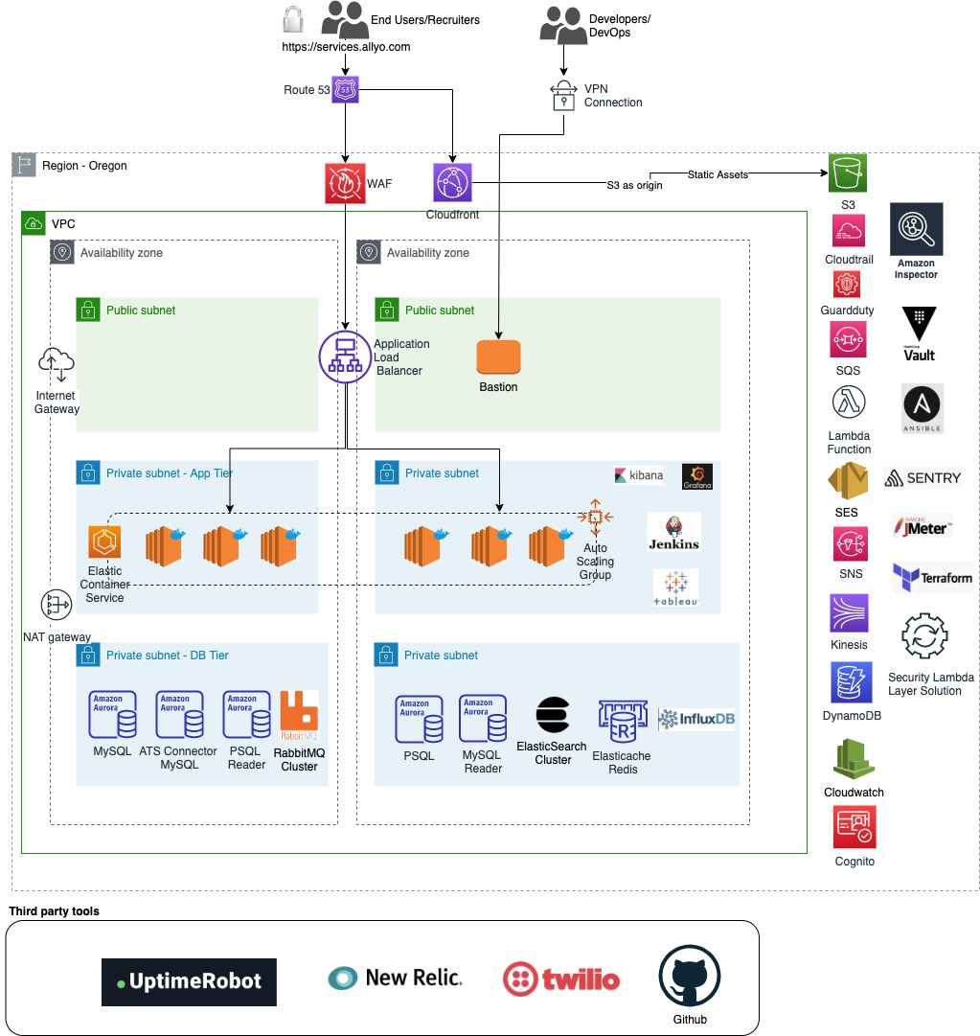
Customer 1

Slide 32
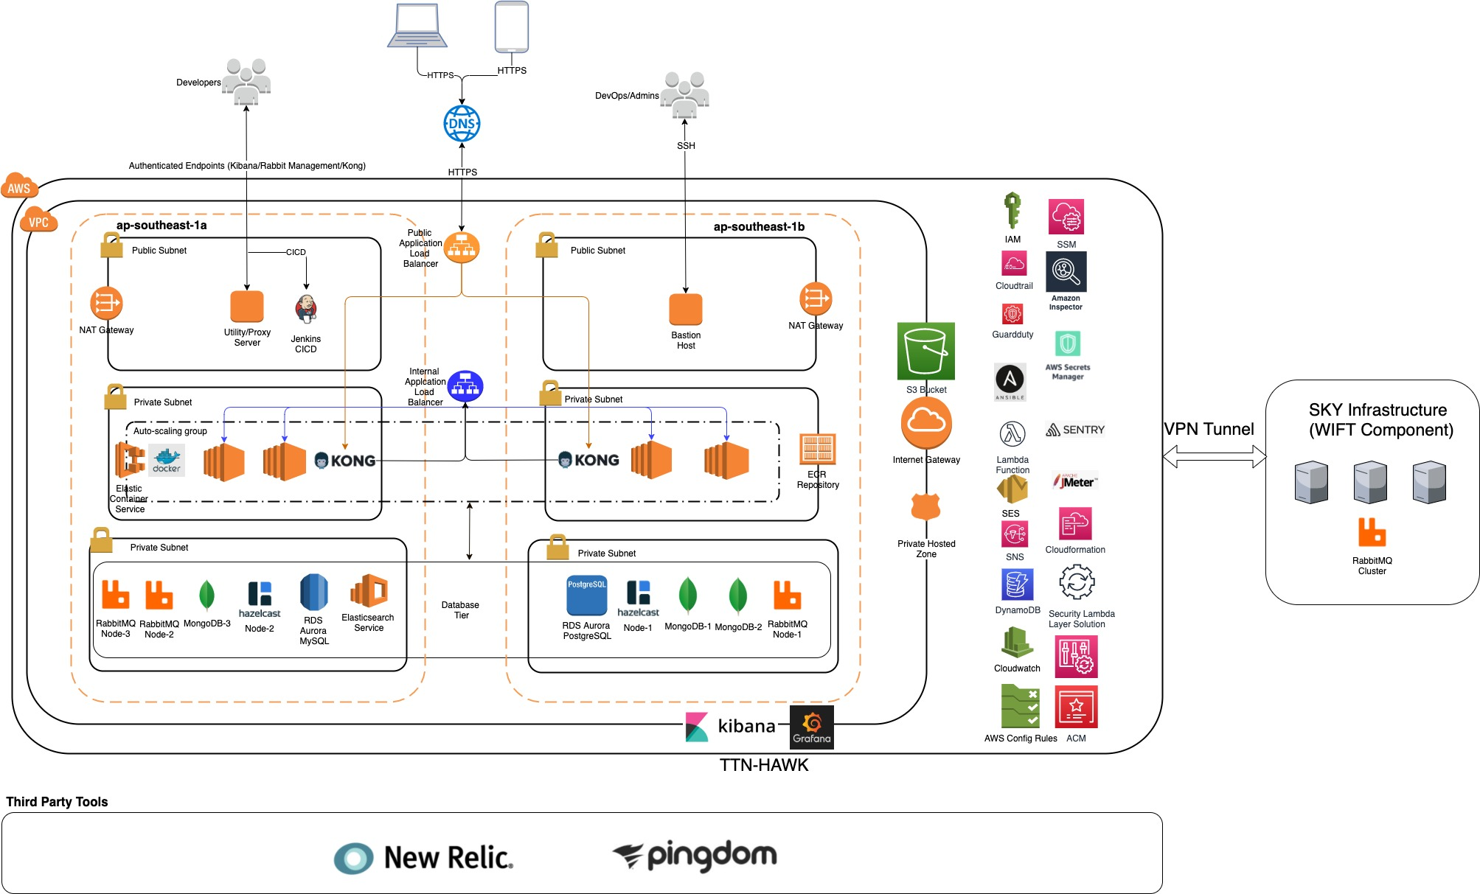
Customer 2

Slide 33
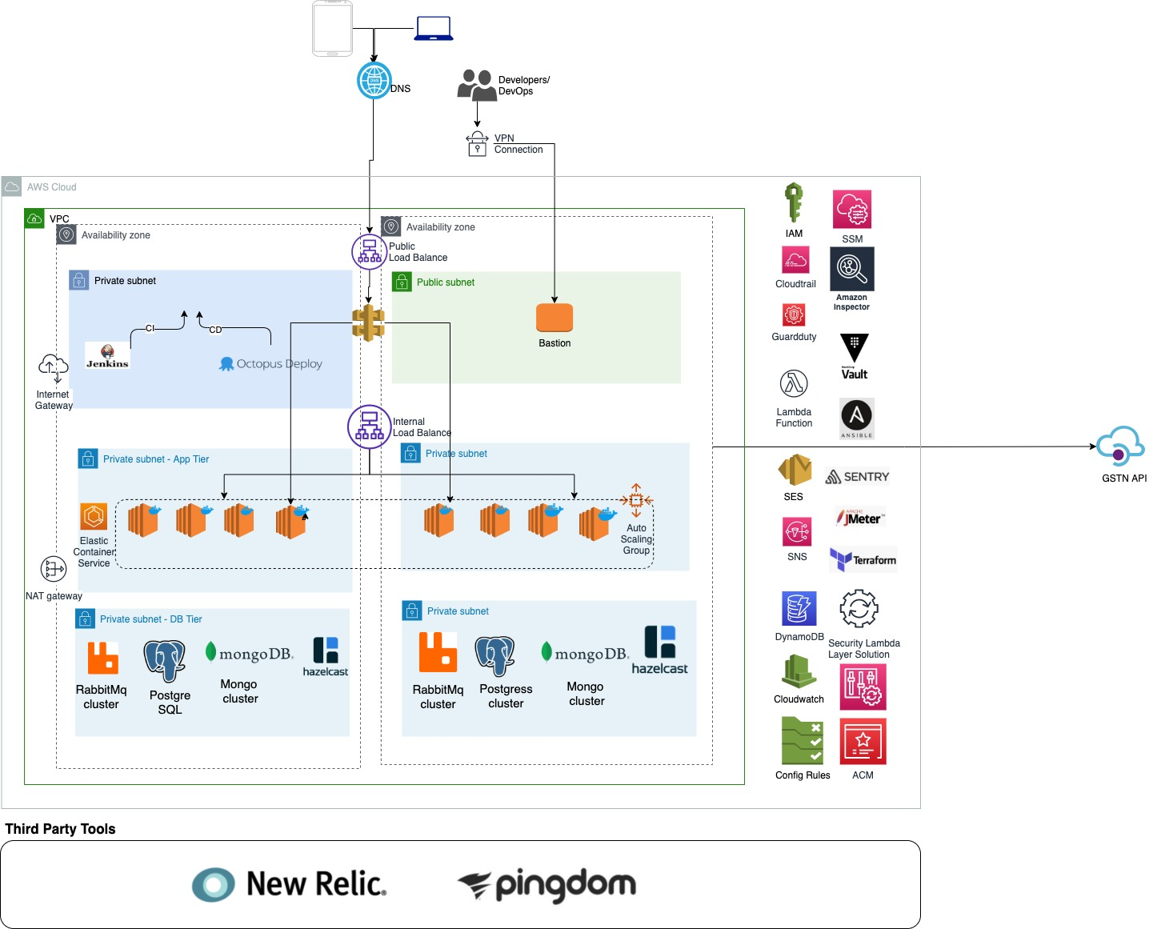
Customer 3

Slide 34
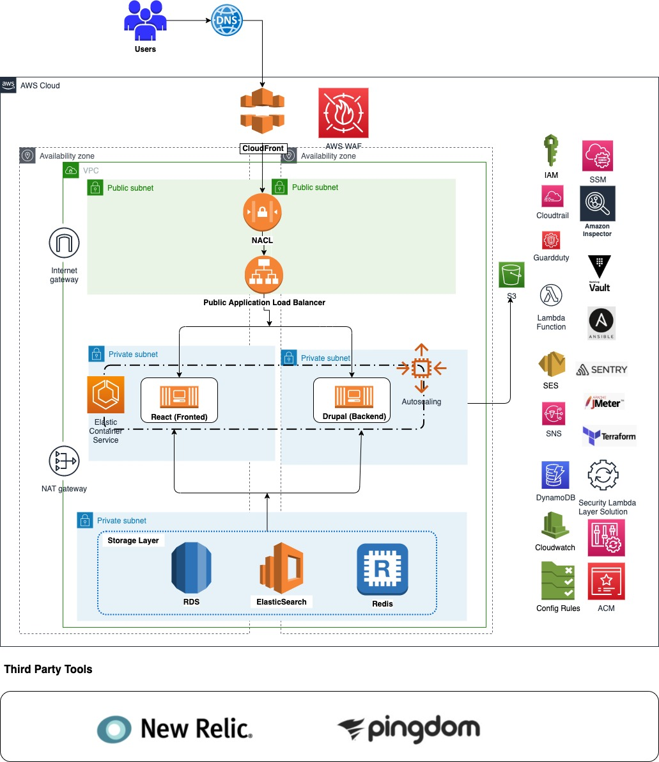
Customer 4

Slide 35



Slide 36
Thank You
Hope you enjoyed the session!
Let us know what you think

Slide 37
Exercise:
List out the types of instance base on the pricing model and write a brief about your understanding about it.
Host a static website in S3.
Launch an Ubuntu EC2 instance on AWS, with 10GB root volume, and SSH from your local machine using the private key.
Install nginx package in the above server and access this page from your local browser using a domain name instead of IP address of the server.
Bonus Question: - Create an architecture on AWS which is provided in next slide:-

Slide 38
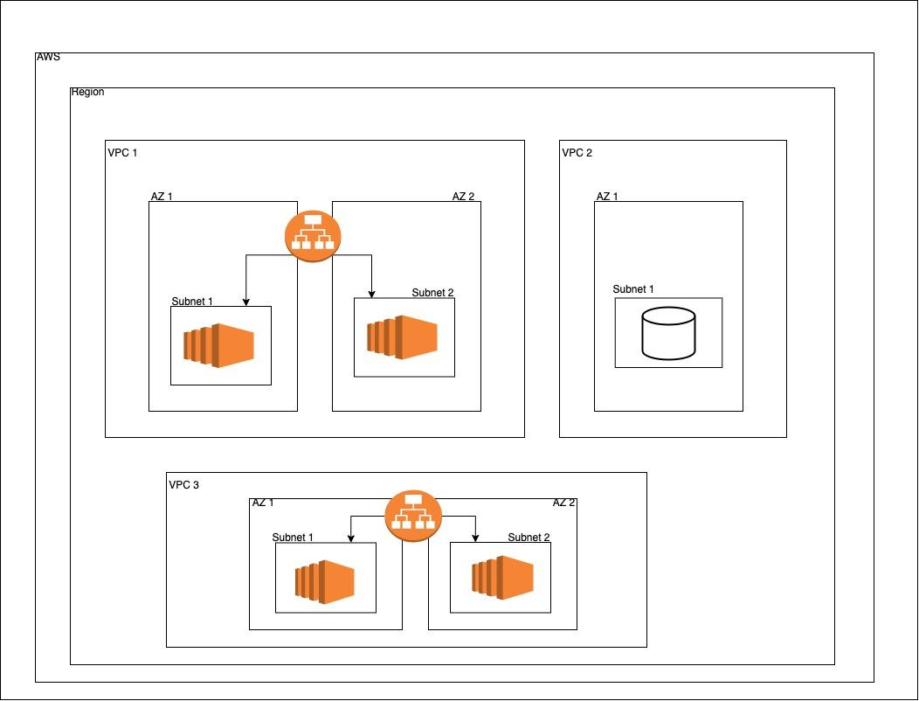
Architecture for Ques. 3

